Slide 1
CSS TRAINING
By Rangaraj Kaushik Sundar

Slide 2
WHO IS THIS FOR?
The curious designer
The furious engineer
The clueless corporate person
And the fearless intern

Slide 3
WHAT ARE WE GOING TO LEARN?
What is CSS ?
The history of CSS.
Basic CSS concepts.
Glimpse into CSS Grid, Flexbox and Media Queries.

Slide 4
What is CSS?

Slide 5

CSS is a stylesheet language used to describe the presentational semantics of a document written in a markup language.

Slide 6


Slide 7
Why is CSS Hard?

Slide 8
“When you code CSS, you’re writing abstract rules to take unknown content and organize it in an unknown medium.
That shit is hard!”
Keith J Grant Author of CSS in Depth

Slide 9
HISTORY OF CSS

Slide 10
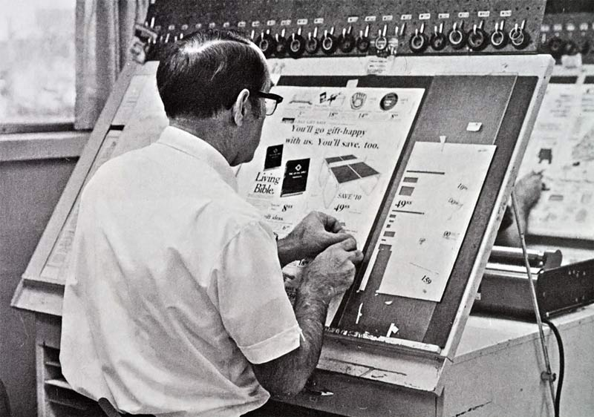

Pasteup

Slide 11

VU Magazine - November 1934

Slide 12
HTML & CSS
HTML was not intended to carry styles, only content.
W3C gave us CSS to style our documents!

Slide 13
CSS BASICS

Slide 14
CASCADING STYLE SHEETS
There are 3 ways in which styles cascade in a web page.

Slide 15

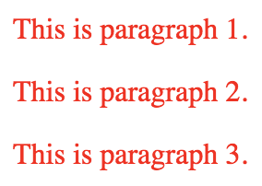
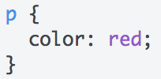
ONE FOR ALL!

Slide 16

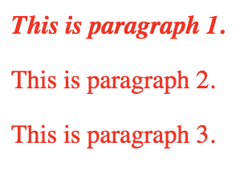
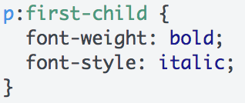
ALL FOR ONE!

Slide 17
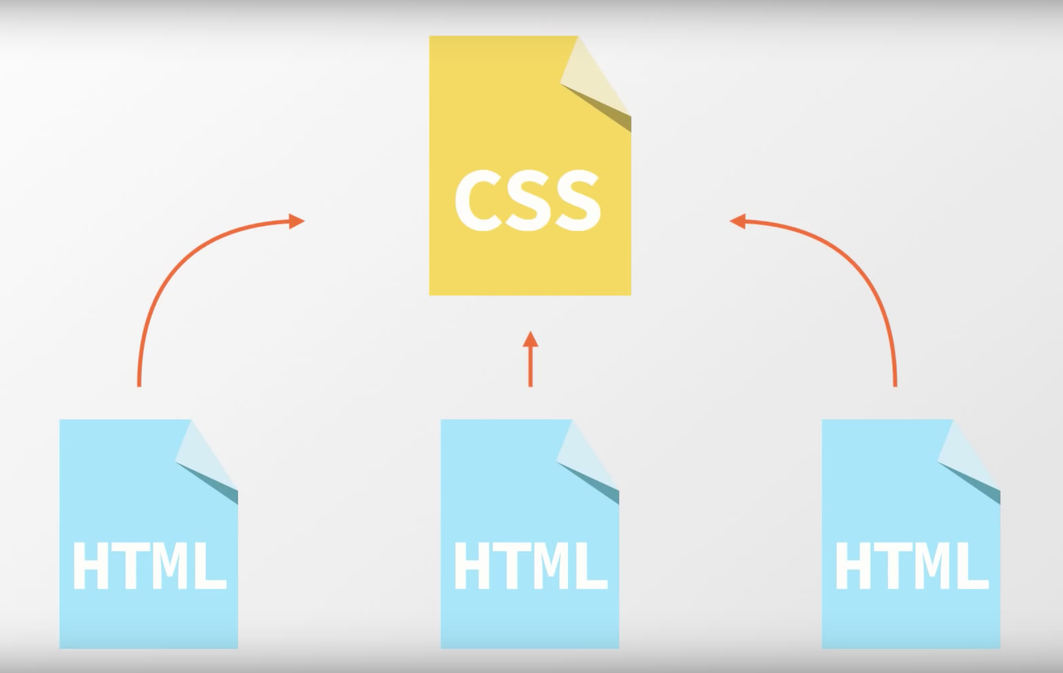
POWER OF EXTERNAL STYLESHEETS

Slide 18
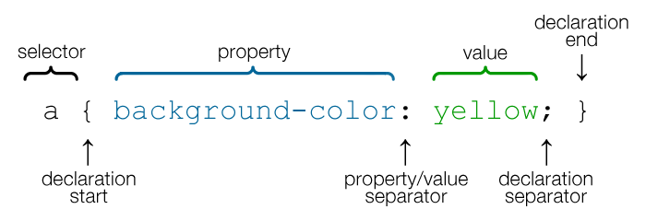
CSS Property and Value

Slide 19

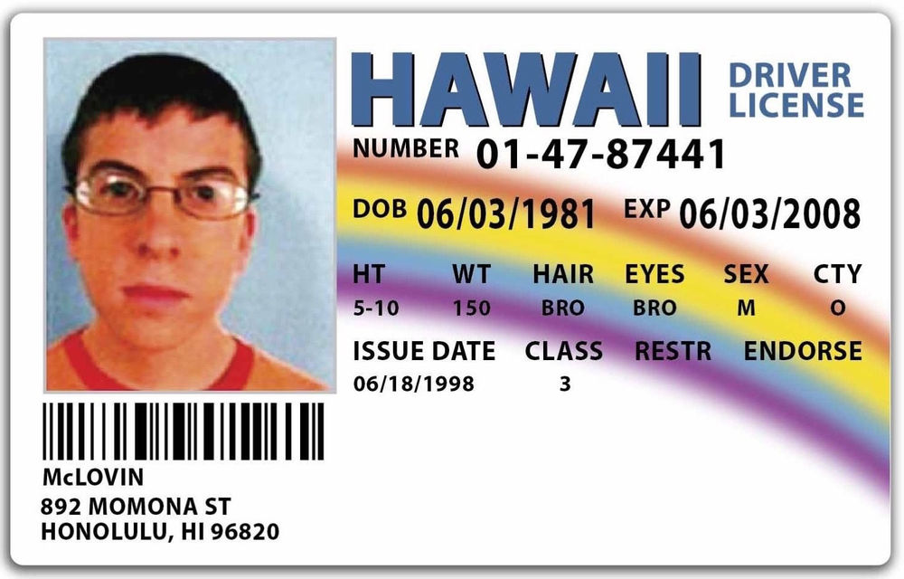
ID
CLASS

Slide 20
CSS SELECTORS

Slide 21
UNDERSTANDING THE DOM

Slide 22
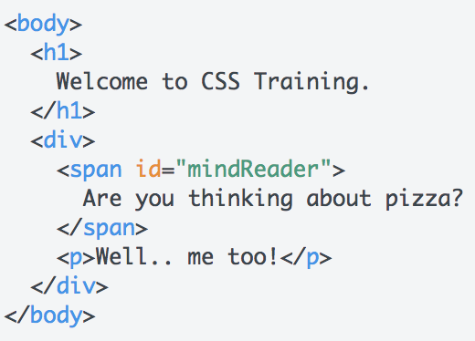
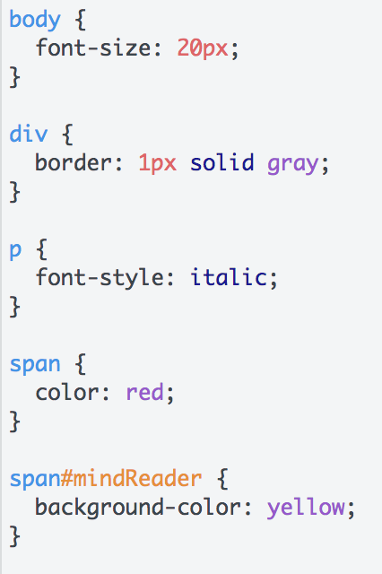
HTML
CSS

Slide 23
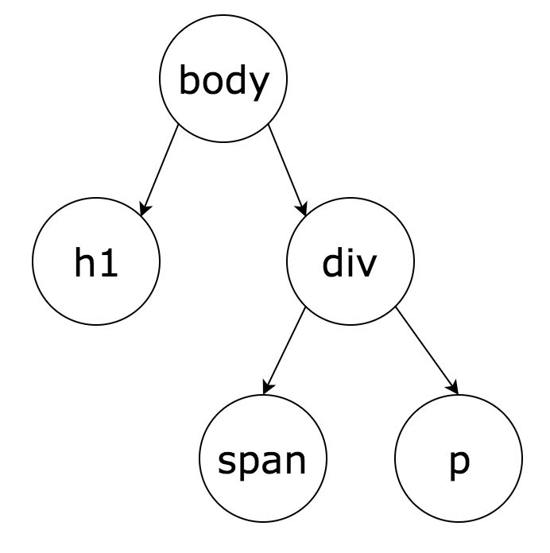
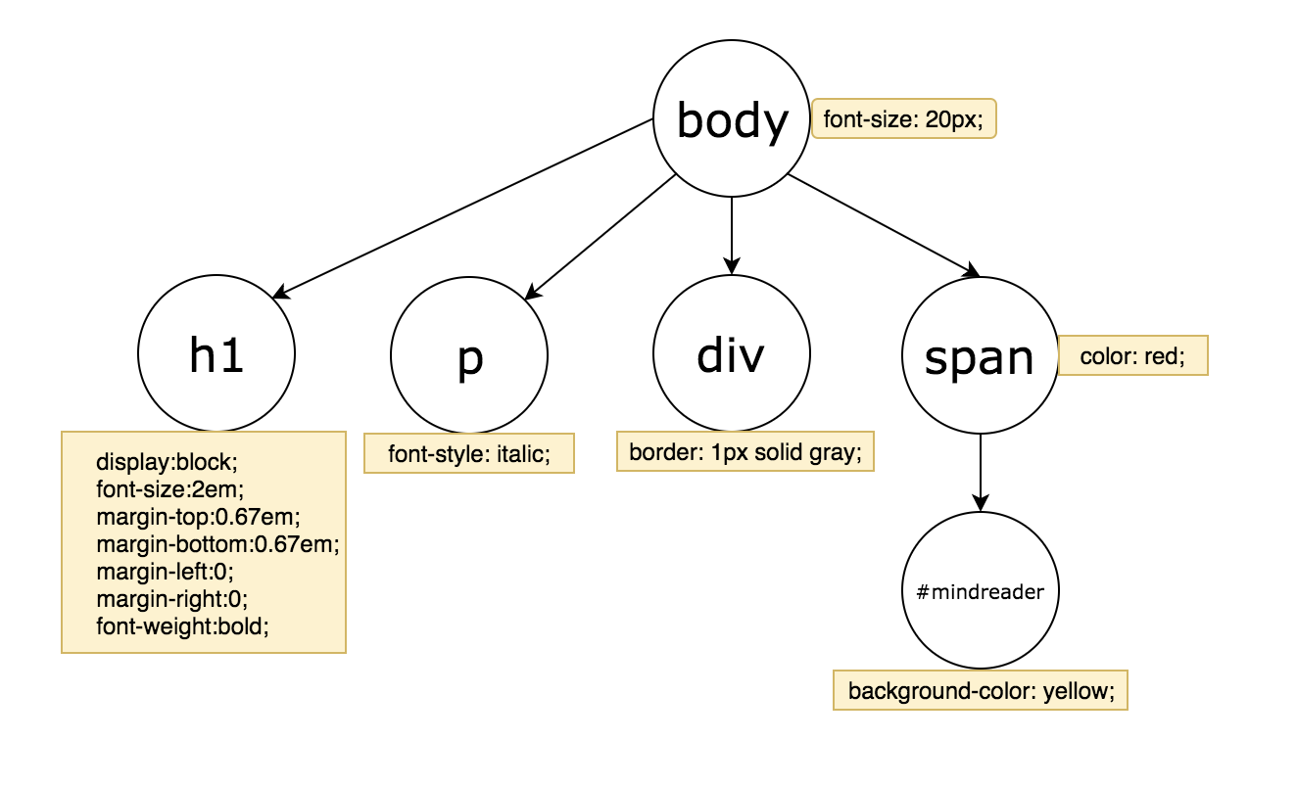
DOM
CSSOM

Slide 24
What happens when you mess up?

Slide 25
HOW TO STYLE
There are 3 ways to use styles
1. Inline CSS
2. Internal CSS
3. External CSS

Slide 26
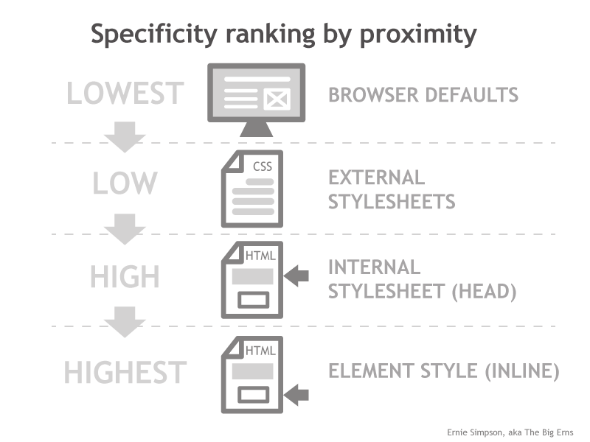
SPECIFICITY

Slide 27
CSS- The frustrating parts
Design is very opinionated.
No error report.
Property overrides.
Browser compatibility.
Units of measurement.

Slide 28
CSS Units
Absolute: px, in, cm, mm, pt, pc.
Relative: %, em, rem, ex, ch, vw, vh, vmax and vmin.

Slide 29
Displays and Positions

Slide 30
Advanced CSS

Slide 31
Thank you!

